Slide 1
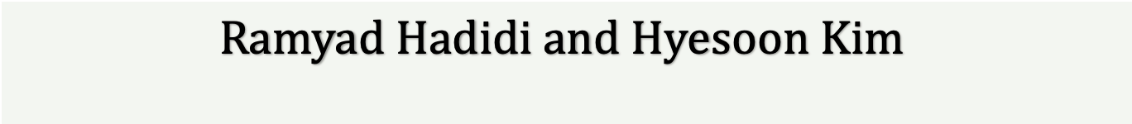
Decentralized In-The-Edge Perception: DNN, System, and Hardware Architecture
$$Ramyad Hadidi and Hyesoon Kim$$

Slide 2
Pushing Inferencing to the Edge
Why?
Unreliable connections to the cloud (bandwidth, latency)
Disconnected Devices
Privacy
Privacy preserving learning (e.g., differential privacy)
Privacy preserving inference (e.g. homomorphic encryption)
Personalization
Federated learning

Slide 3
Applications
Resource-constrained robots
Drones
Swarm robots
Autonomous vehicles with several sensors
Smart environments with IoT devices
Resource-constrained platforms

Slide 4
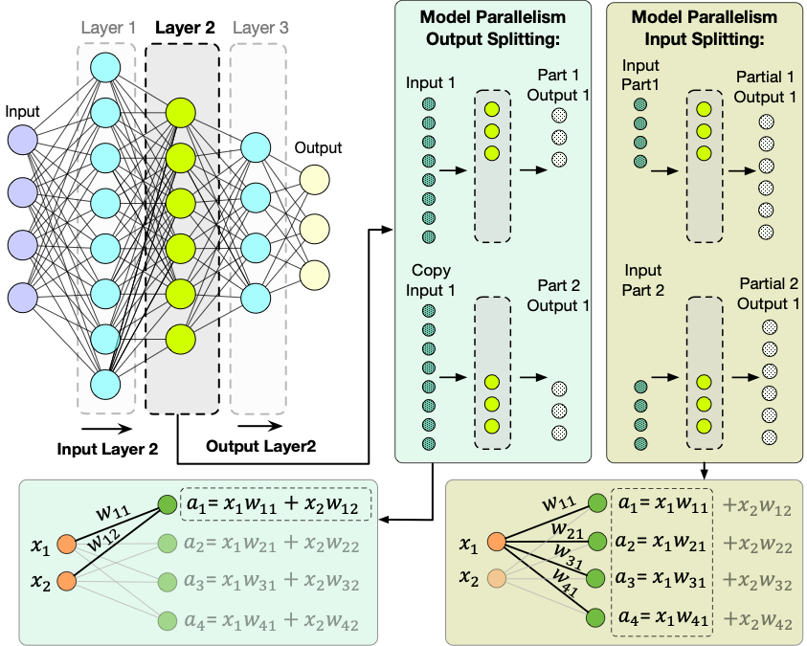
Ex.1 Distribution Methods
How to distribute DNN models to get higher bandwidth / latency
Fully-connected and convolution layers
Distribution and task assignment algorithms
Notes:
use group of robots
each robot takes small portion of computation
in order to collaborate

Slide 5
Ex.2 Collaboration
Usually, many cheap robots share their environment.
Not all robots need to perform computations at same time.
So What if they share their knowledge and help each other?
Notes:
use group of robots
each robot takes small portion of computation
in order to collaborate

Slide 6
Ex.3 Virtualization
Deploy a Docker-based cluster on Rpis
SysML’19 Demo
http://comparch.gatech.edu/hparch/sysml
Notes:
use group of robots
each robot takes small portion of computation
in order to collaborate

Slide 7
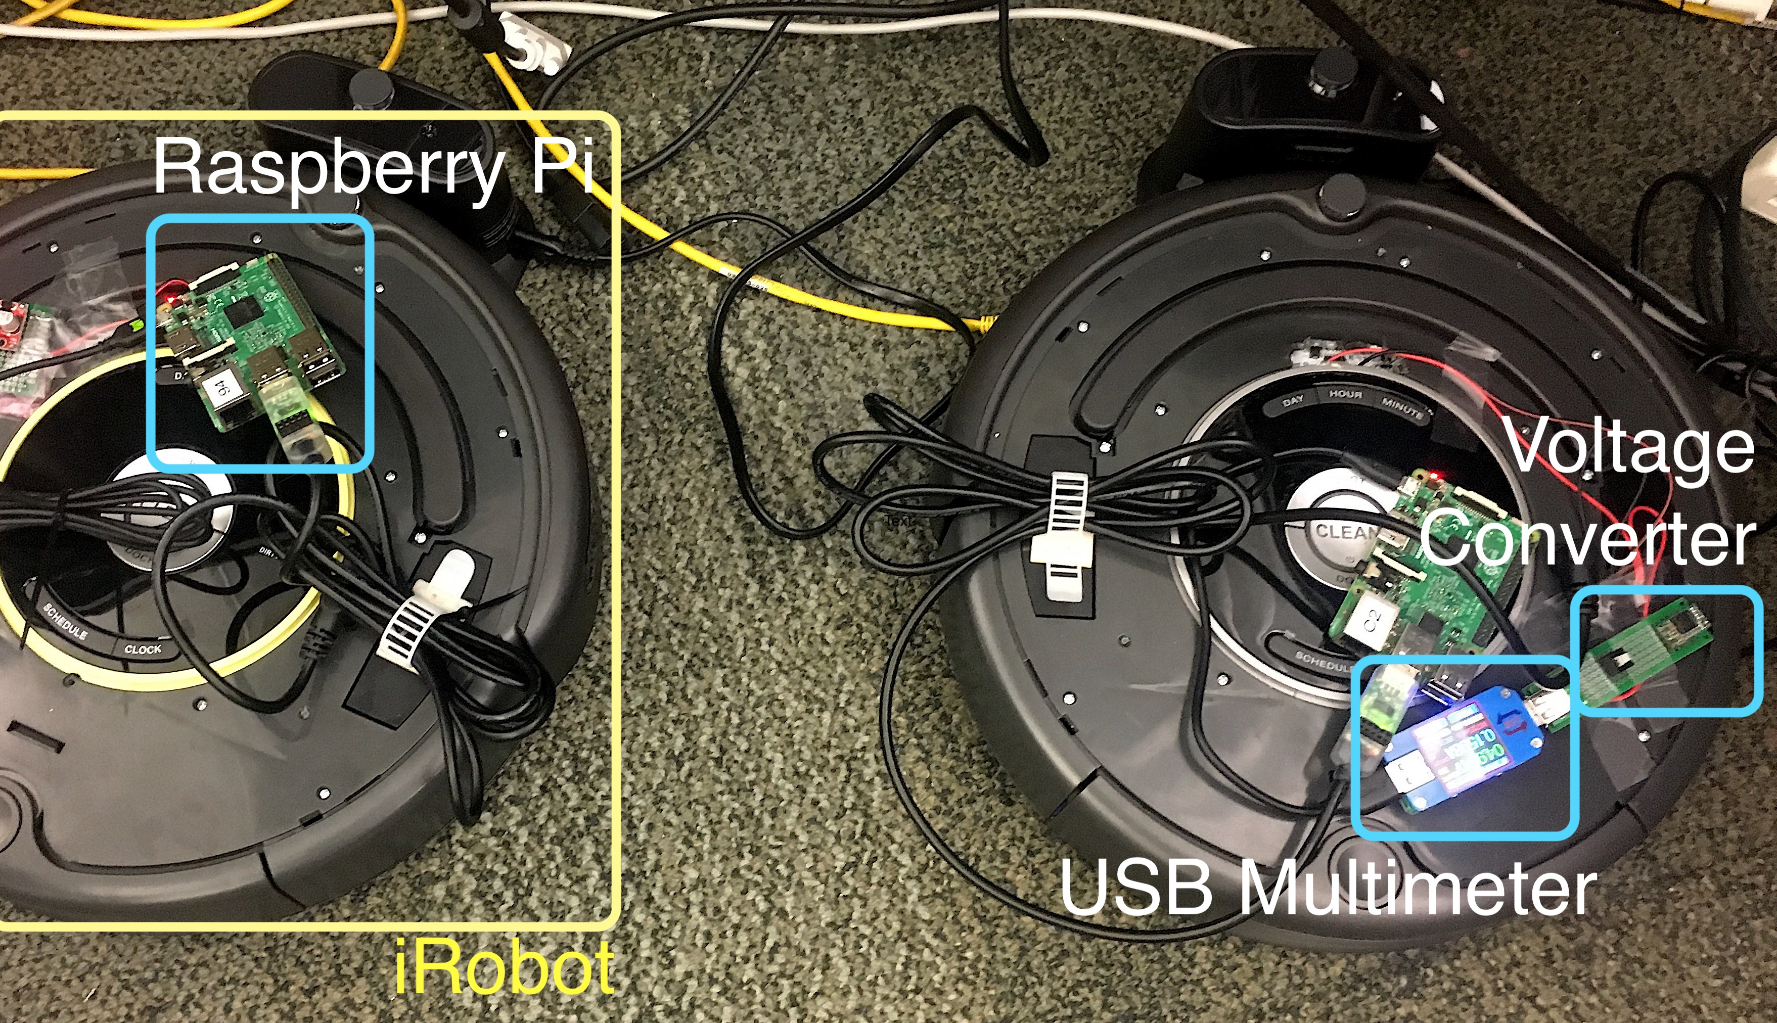
Ex.4 iRobots
Equip iRobots with RPi3s
Measured performance and characteristics
Undergraduates work for Fall’19
Notes:
use group of robots
each robot takes small portion of computation
in order to collaborate

Slide 8
Ex.5 Fault-Tolerance of Distributed DNN Models
Increase fault tolerance of DNN models with CDC methods
More compute per node = more robustness
Derive the tolerance relationships
Notes:
use group of robots
each robot takes small portion of computation
in order to collaborate

Slide 9
Ex.6 Accelerator Design for The Edge
Edge specific accelerator desings
Notes:
use group of robots
each robot takes small portion of computation
in order to collaborate

Slide 10
Ex.6 Edge-Tailored DNN Models (ETP)
Designing specific models that are ideal for distribution
Submitted to MICRO’19
Notes:
use group of robots
each robot takes small portion of computation
in order to collaborate

Slide 11
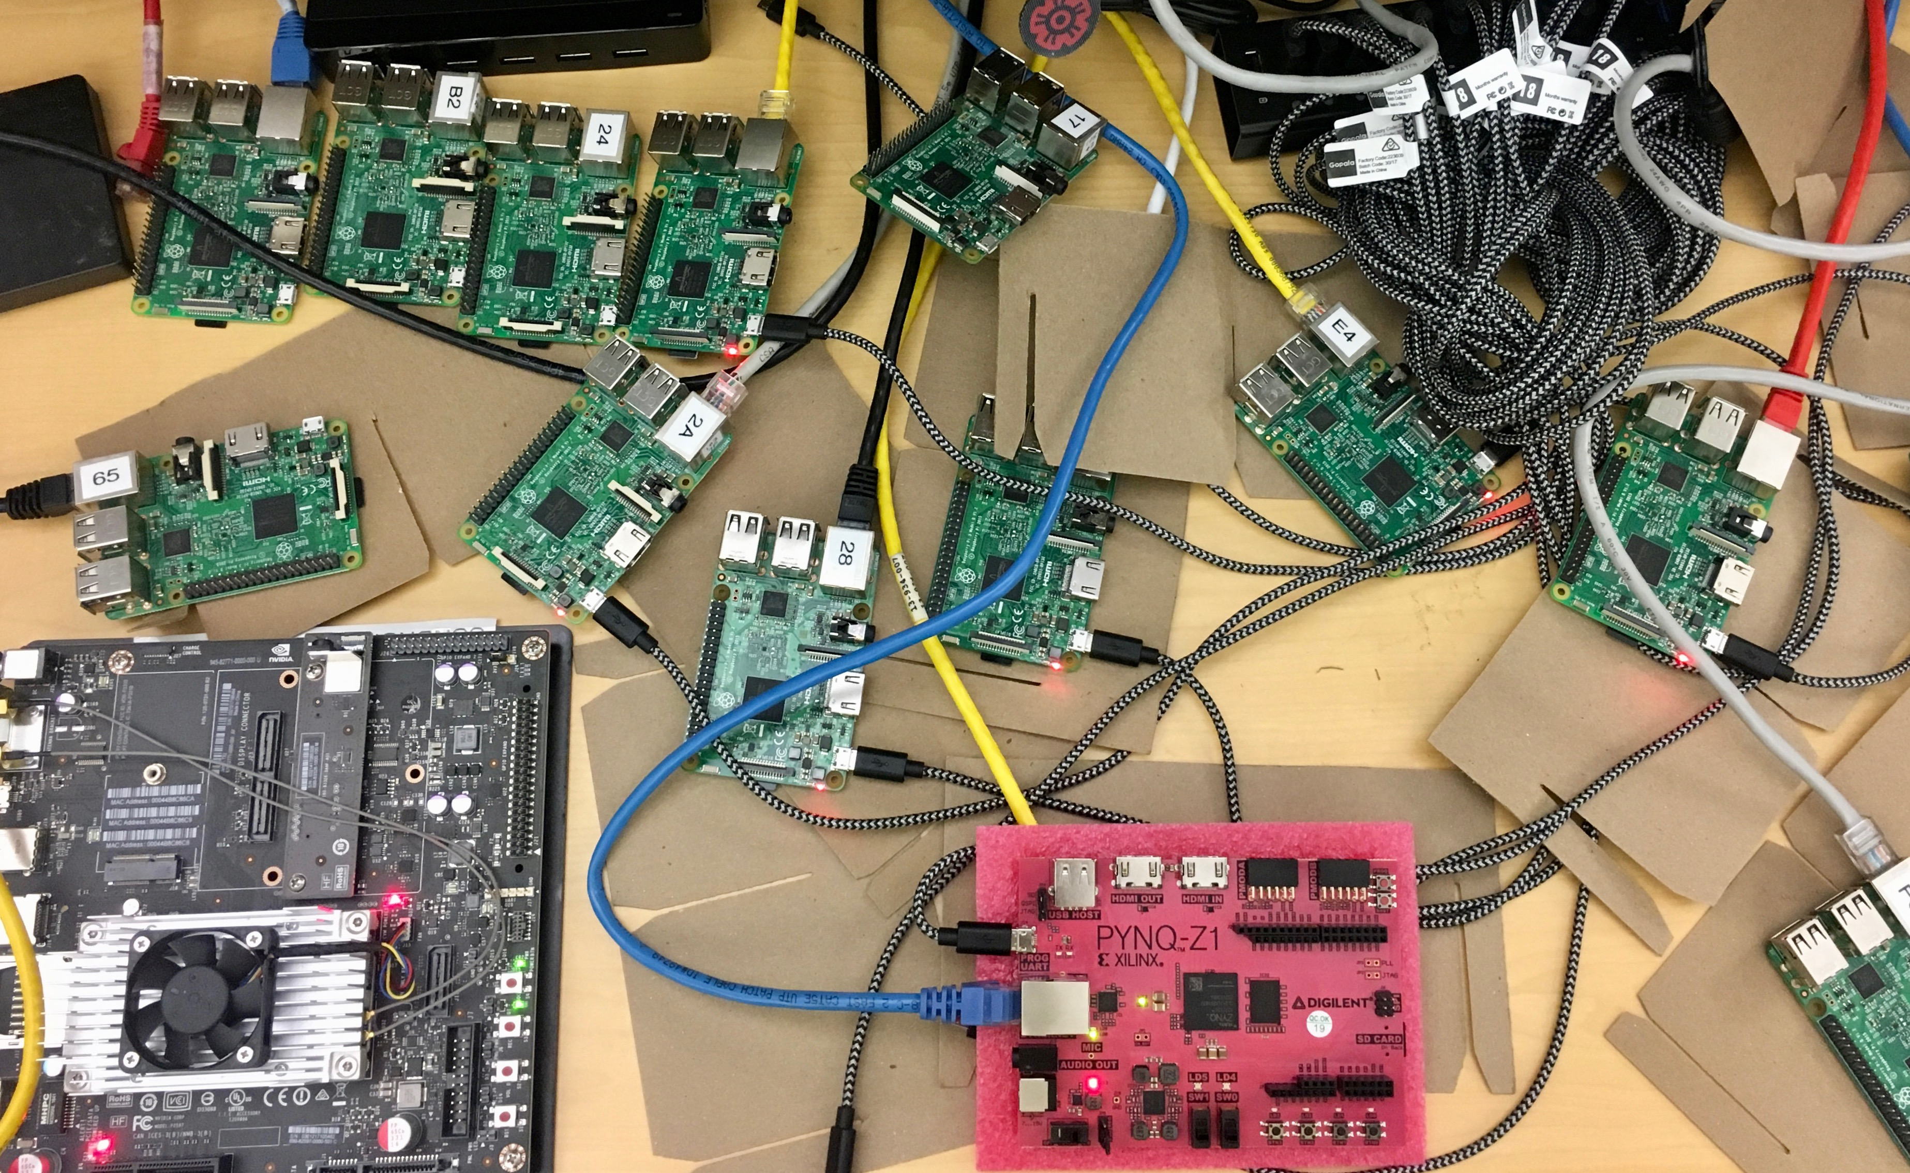
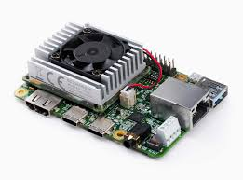
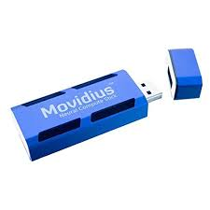
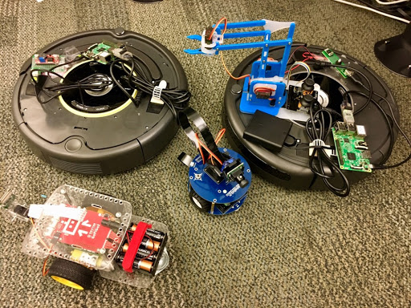
Future Directions
Edge Devices Characteristics
Virtualization
Robots
FPGA-based designs
Specific DNN Models
Email: rhadidi@gatech.edu
Notes:
use group of robots
each robot takes small portion of computation
in order to collaborate

Slide 12
Notes:
use group of robots
each robot takes small portion of computation
in order to collaborate

